Slide 1
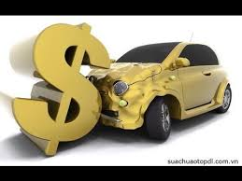
Insurance Fraud Detection
-Musab Khan

Slide 2
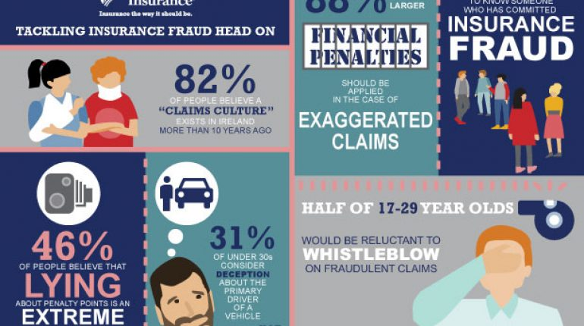
ABSTRACT
The impact of fraud related losses is increasingly severe as new and innovative ways to defraud insurance companies are on the rise. While all insurance companies have a mechanism to detect insurance fraud, most of them do so using a traditional approach, based on business knowledge of insurance SMEs and SIUs, by creating a rule based fraud detection engine. However, a new trend of using data analytics for prediction of insurance fraud has emerged over the last few years.

Slide 3

Data-Set
Columns- ['months_as_customer', 'age', 'policy_number', 'policy_bind_date', 'policy_state', 'policy_csl', 'policy_deductable', 'policy_annual_premium', 'umbrella_limit', 'insured_zip', 'insured_sex', 'insured_education_level', 'insured_occupation', 'insured_hobbies', 'insured_relationship', 'capital-gains', 'capital-loss', 'incident_date', 'incident_type', 'collision_type', 'incident_severity', 'authorities_contacted', 'incident_state', 'incident_city', 'incident_location', 'incident_hour_of_the_day', 'number_of_vehicles_involved', 'property_damage', 'bodily_injuries', 'witnesses', 'police_report_available', 'total_claim_amount', 'injury_claim', 'property_claim', 'vehicle_claim', 'auto_make', 'auto_model', 'auto_year', 'fraud_reported‘]

Slide 4
Approach
Understanding Problem Statement
EDA-Exploring trends in Data Set
Model Building
Model Evaluation
Results & Outcome
Recommendations and Key Points

Slide 5
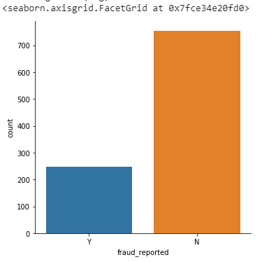

Total Fraud Reported

Slide 6
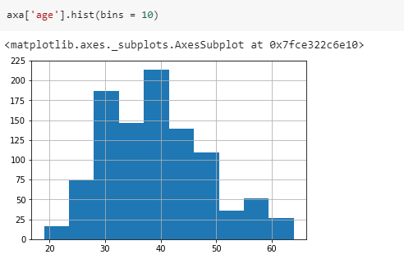
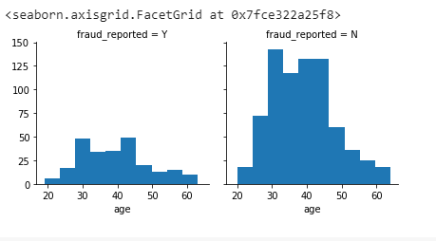
Age
Customer age Fraud Reported w.r.t Customers Age
Younger drivers are ‘more fluid’ in their interpretation of insurance fraud compared to older drivers.

Slide 7
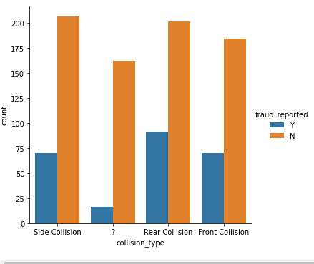
Collision Type
Maximum accident
cases were of
Side-collisions
followed by the Rare
and Front Collisions.
Also, Missing values
denoted by ‘?’

Slide 8
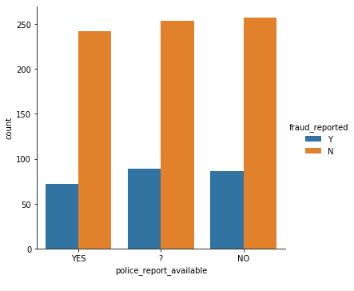
Police Reports
Maximum fraud cases were not having the police reports,
Also equal number of cases did not had enough Information
about police reports. This definitely shows chances of frauds are high.
Comparatively fewer cases were having Police Reports.

Slide 9
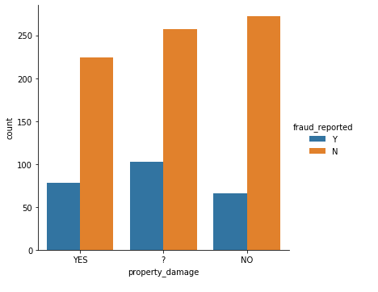
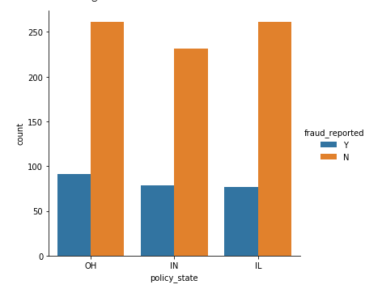
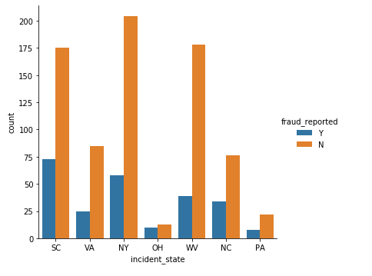
Propety Damage,Policy State & Incident State Insights

Slide 10
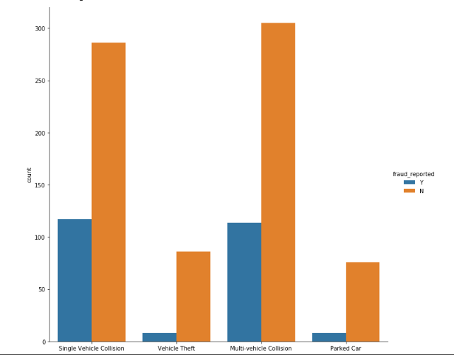
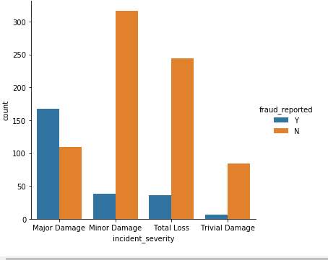
Insights of Accidents severity and Types

Slide 11
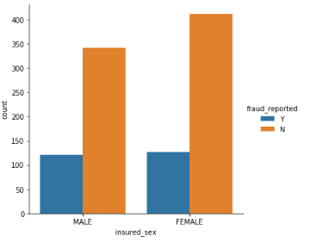
Insured Sex
Our Female Customers were more then Male Customers
Maximum Females were involved in reporting the accidents.
Females contributed to more fraud cases then males

Slide 12
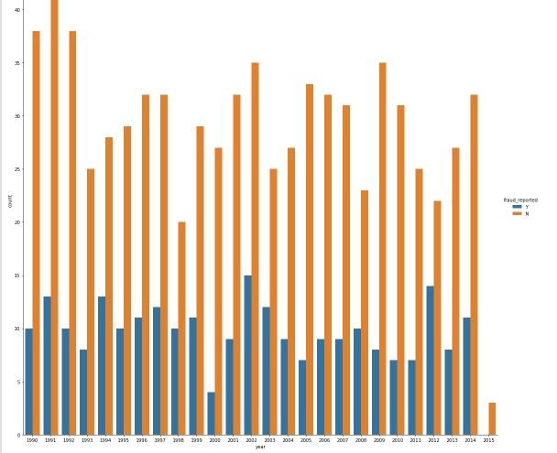
Year wise Insights of Frauds
Shows clearly which year has maximum frauds and minimum or least Frauds cases

Slide 13
Policy Number is essentially a pseudo-identifier, and hence can be safely dropped for the purpose of our study
We suspect that policy_bind_date, insured_zip, incident_date, incident_location and auto_year may contain unmanageable number of levels, and hence may need to be dropped after further exploration.
Variables 'collision_type', 'property_damage' and 'police_report_available' contain unknown ('?') values. We will need to explore these variables separately and figure out how to deal with these.

Slide 14
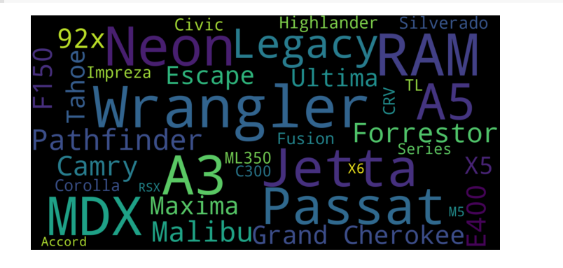
Word Cloud of Car Make
Font Size of word shows highest frequency of that Company ‘s cars used by their customers

Slide 15
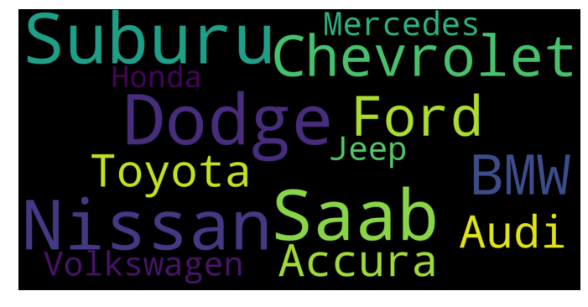
Word Cloud of Car Model
Font Size of word shows highest frequency of that Company ‘s cars used by their customers

Slide 16
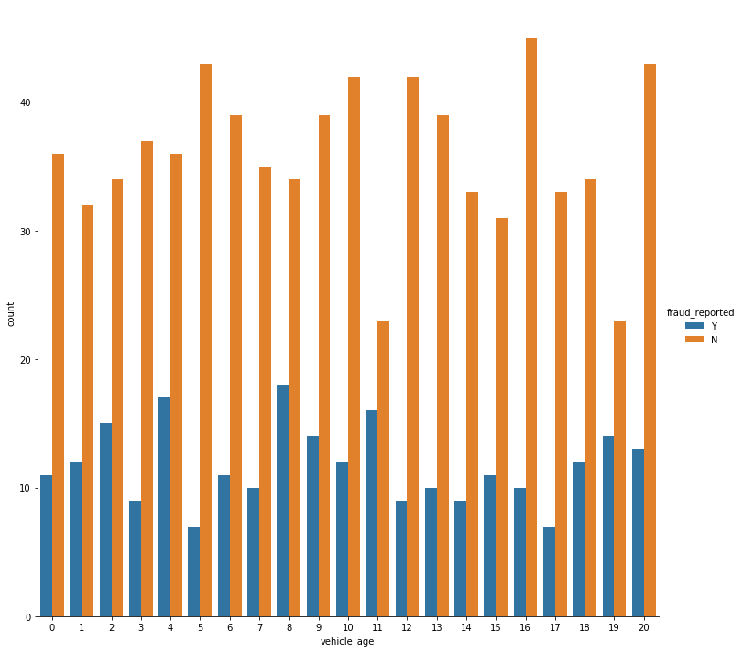
New Features -Vehicle Age
axa['vehicle_age'] = 2015 - axa['auto_year']
Max fraud cases were of the vehicles with age
8 years followed by 4 yrs,11yrs an 2yrs.

Slide 17
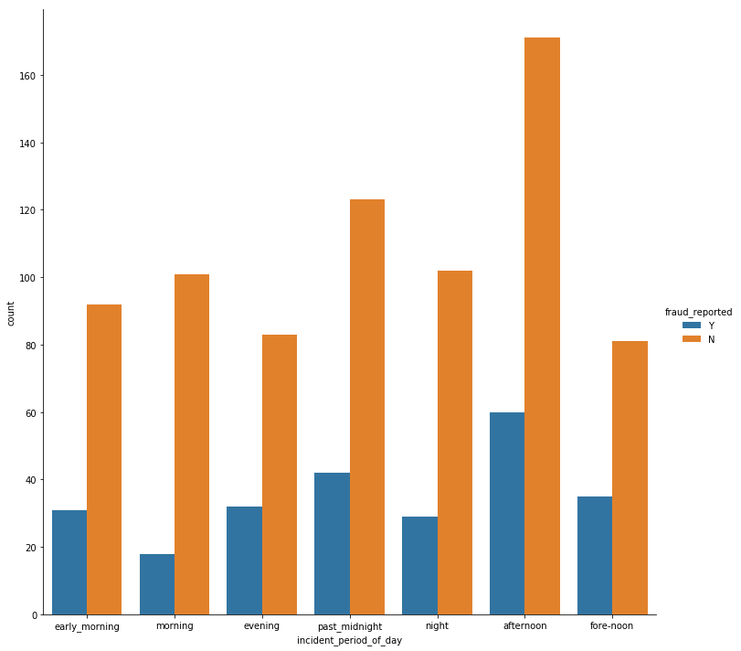
New Feature-Period of the day
axa['incident_period_of_day'] = ["past_midnight", "early_morning", "morning", 'fore-noon', 'afternoon', 'evening', 'night']
w.r.t
bins = [-1, 3, 6, 9, 12, 17, 20, 24] hr of the day

Slide 18
Encoding
After handling missing values and creating new features we have done Label Encoding as maximum columns were categorical.

Slide 19
Training

Slide 20
Testing

Slide 21
Conclusion
There are several statistical and machine learning algorithms used for classification to predict insurance fraud.
These include - - Decision Trees - Support Vector Machines - Neural Networks - Boosting - Bagging - Random Forests While selecting a particular model for making predictions, it is important to take into consideration the characteristics of the data, the strengths and weaknesses of the algorithm, accuracy of the algorithm to make correct predictions, and speed and scalability of the algorithm.
General pitfalls to avoid are
a. Avoid using meaningless or noise variables for model building
b. The class imbalance problem should not be overlooked
c. Over fitting the model to training data should be avoided Accuracy of the model can be viewed through the confusion matrix. For many of the algorithms, like Random Forest, CART, CHAID, it is possible to add a penalty for wrong prediction. E.g. if avoiding fraud loss is more important than avoiding unnecessary investigation for non-fraud cases, one can add a penalty for incorrect prediction of a case as not fraud.
This will reduce “Incorrect prediction as Not Fraud” and improve accuracy of correct fraud prediction. Ensemble models are widely used for insurance fraud prediction. Ensemble models are based on the idea that by combining weak learners, a strong learner is created. Bagging, boosting and random forest are examples of ensemble models.

Slide 22
Conclusion
Advantages of using ensembles are
a. Reduces chance of over fitting – No single bias is able to dominate because opinions of several learners are incorporated.
b. Improves performance – Since ensembles create several smaller models as against a single large model, computing performance can be improved. Also, it is easier to parallelize an ensemble using distributed computing methods
c. Provides a better understanding of difficult learning tasks – Real world problems are complex.
Models that divide the task into smaller parts can capture subtle patterns more accurately than a single model might. d. An ensemble like random forest can be used with data with extremely large features or examples. It selects most important features and performs well on most of the problems

Slide 23
Key Take Away
The Data Analytics approach provides a new approach for prediction of fraud using the organizations data as an asset. More and more insurance companies have started to incorporate this approach in their fight against fraud.
There are several techniques such as predictive modeling, text analytics, unsupervised learning, and social network analysis that help to bring out insights from historical data and use them for prediction of frauds in new claim data.
For each of these techniques, there are multiple algorithms available which allow organizations to take advantage of these techniques.
These techniques and algorithms for these techniques have provided new tools to insurance organizations to combat fraud.

